Slide 1






Tanks Adventure
Final project of COMP 486 – Zhong He
Notes:
Hello

Slide 2
Game Introduction
Adventure browser game
Game story: The game is about robot tank battles. The player controls the robot tank - “Red Comet” which needs to upgrade and use weapons including the main gun, the machine gun and drones to try to defeat more enemy tanks on the field.

Slide 3
Game Introduction
Main Characters:
Boss will appear after every 4 kills of enemies
Player
Type 1 Enemy
Type 2 Enemy
Type 3 Enemy
Boss

Slide 4
Game Introduction
Game controls:
Keyboard:
‘W,A,S,D’ or ‘arrow keys’ to move the tank
‘1,2,3’ to switch between different weapons
‘space’ to fire bullets
‘Enter’ or ‘left shift’ pause or continue the game
Mouse:
Aim enemies, the turret will be rotated towards the pointed direction by the mouse cursor
click upgrade options in ‘upgrade’ interface

Slide 5
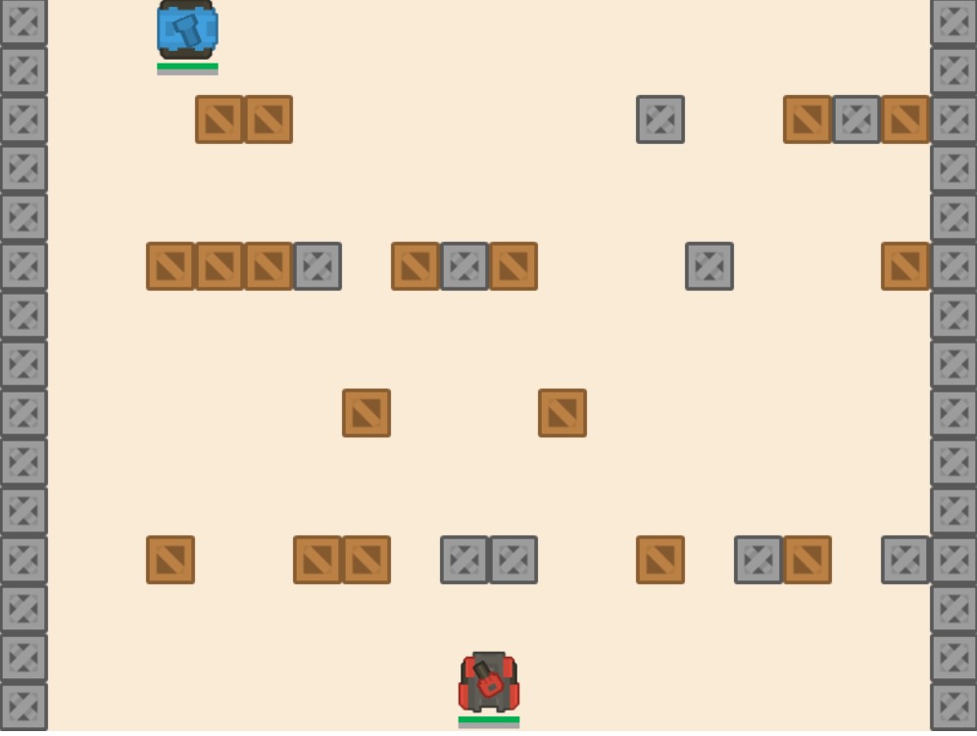
Game Design
Game interface
Scrolling

Slide 6
Game Design
Weapons(previous version):
Main gun: reload after each shooting
Piercer bullet: higher penetration, lower damage.
Explosive bullet: lower penetration, higher damage.

Slide 7
Game Design
Effect armour: Calculated by geometry
Enemy tank
Fired bullet
Impact angle

Slide 8

Game Improvements
New weapons:
Machine gun: magazine system, lower penetration, lower damage, shoot at least 10 bullets in a short period of time.
2. Drones:
Automatic moving, shooting and reloading

Slide 9
Game Improvements
Weapon improvements:
Piercer bullet: it has some chance to make critical hits with extra damage.
Explosive bullet: it is able to make burning damage(damage over time).
Extra health for the player for each game

Slide 10
Game Improvements
Loot box:
Dropped by killed enemies
Regular enemies drop coins
Bosses have some chance to drop free upgrades instead of coins

Slide 11
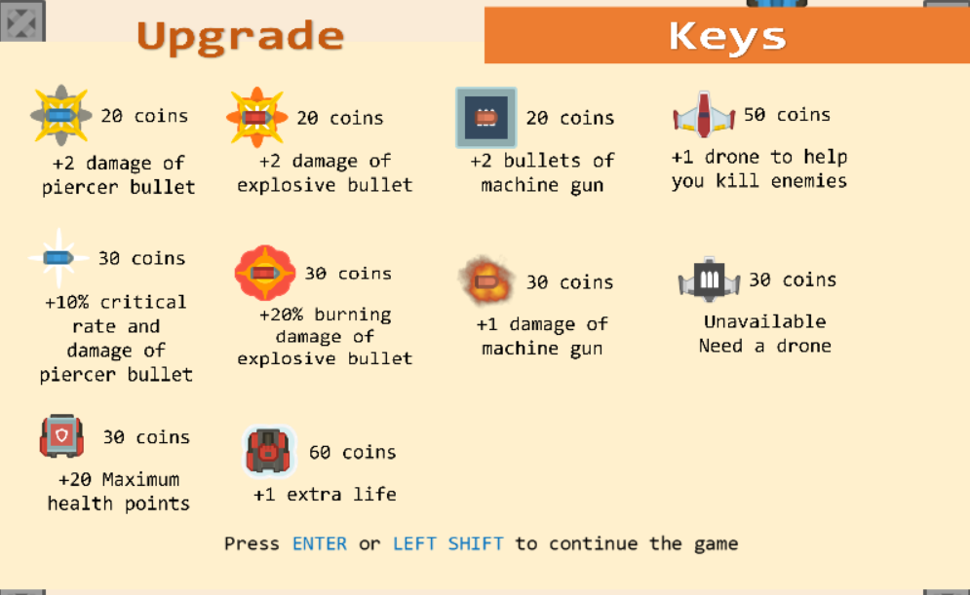
Game Improvements
Upgrades:

Slide 12
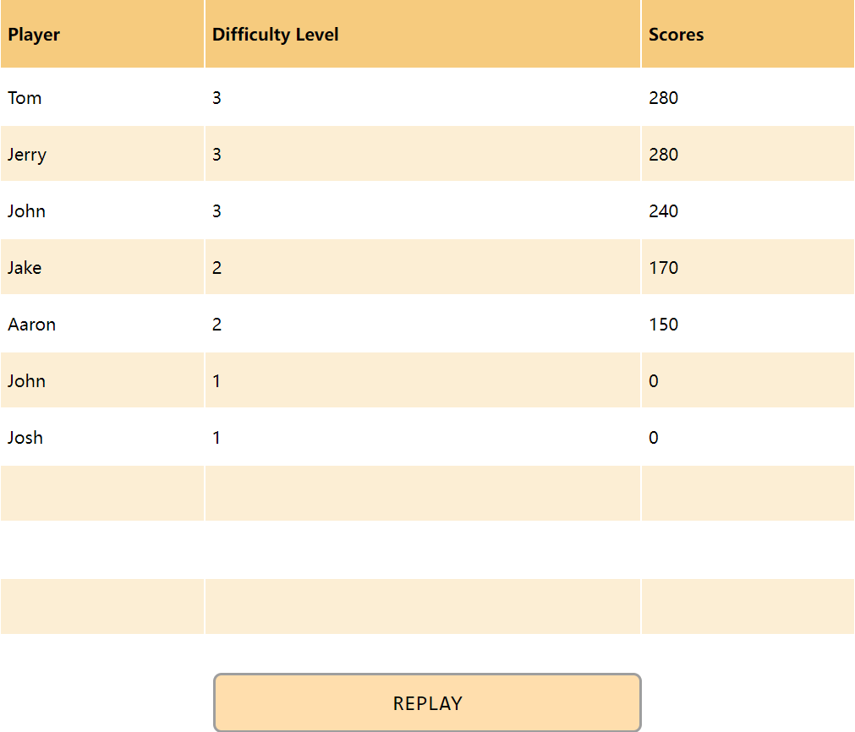
Game Improvements
Score records:

Slide 13
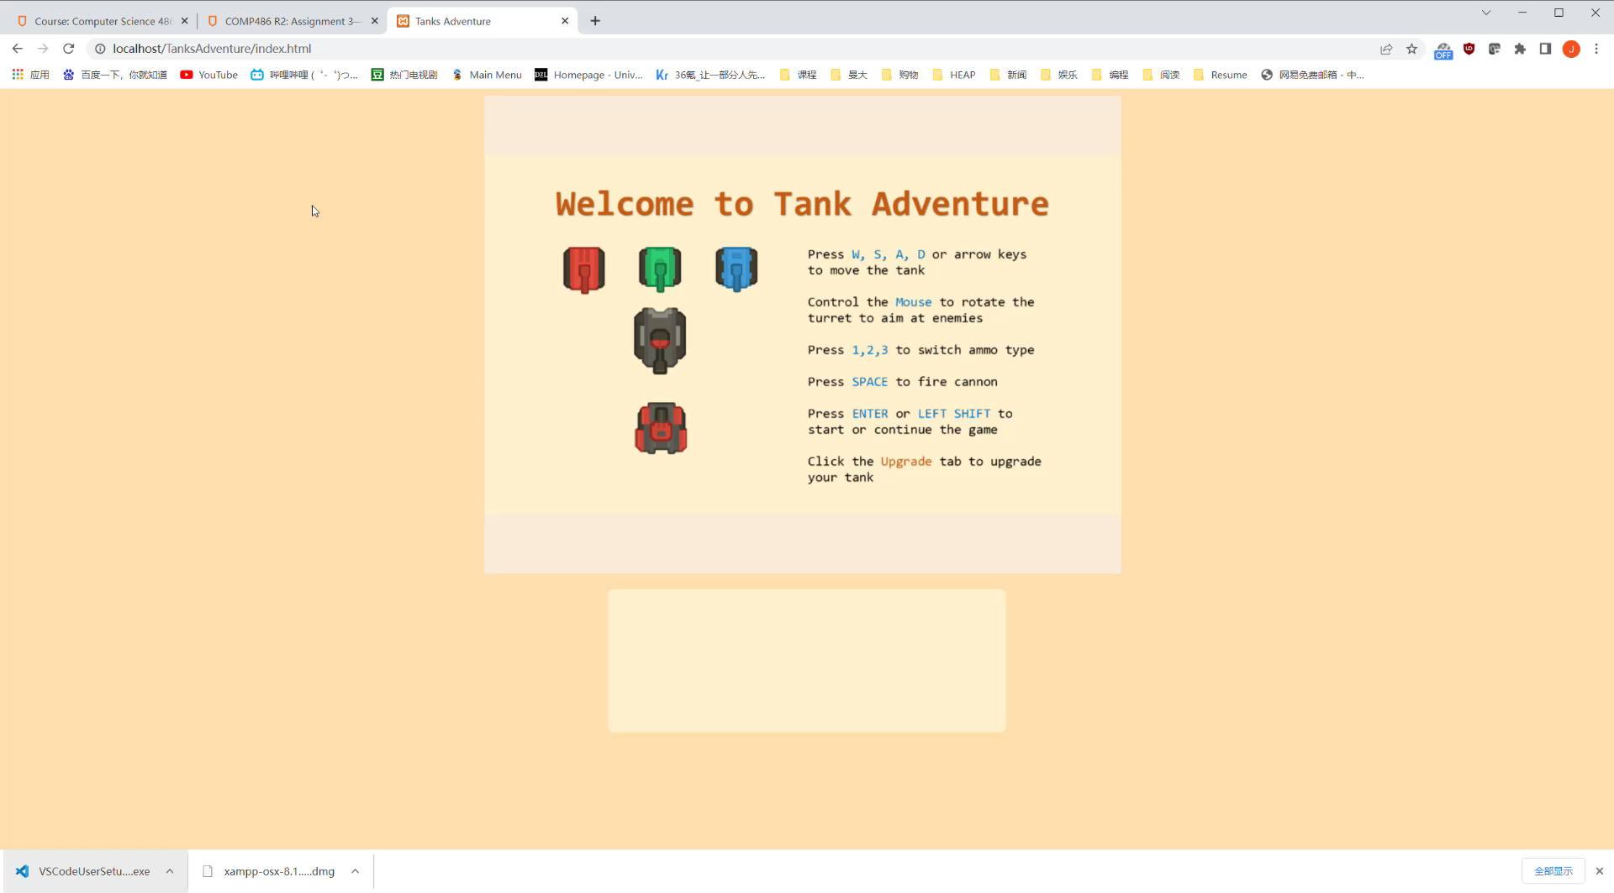
Game Demonstration
Demo

Slide 14
Game Demonstration
Live Demonstration

Slide 15
Game Development
HTML, JavaScript, PIXI.js, CSS, PHP, SQL
Virtual Studio
XAMPP

Slide 16
Game Development
Challenges:
1. Game ideas: player, enemies, boss and upgrades
2. PIXI.js game design
3. Collision detection
4. SQL database in local server
5. Passing JSON between PHP and JavaScript
6. In-game values balancing and tests

Slide 17
Q & A

Slide 18
Thank You

